Slide 1

WNR Cycle 3 Review
2/25/2016

Slide 2
Motivation & Scope
Patients with severe epilepsy untreatable by medicine or therapy have to undergo invasive epilepsy surgery, to localize the source of the epileptic brain activity through intracranial EEG with a resolution greater than what is provided by scalp EEG.
Such data collecting procedures are invasive, expensive, and time-consuming. The current standard is to use a bedside rolling station with a monitor and computer racks that have wires connecting the electrocochleography system directly to the patient’s brain. This confines them to their hospital beds for days on end with barely any interaction or motion, severely limiting their quality of life.
WNR is producing a new ECoG (a.k.a. Intracranial EEG) electrode that incorporates wireless connectivity via Bluetooth Low Energy between each individual intracranial electrode probe and a central recording terminal. Each electrode will be attached to a low-power analog to digital unit that will read and transmit neural data to a bluetooth microprocessor to transmit wirelessly in real-time to a receiver. An array of up to 16 wireless electrodes should be able to transmit simultaneously to a single recording receiver. From the receiver, medical professionals can access the data in real-time and analyze the captured data to best treat the patient. Our embedded system seeks to untether the patients and give them their mobility and their life back.

Slide 3
Customer Needs
Safety & Regulations
FDA Medical Device & HIPPA Data Privacy Requirements
Do not heat up the surrounding skin by a change of more than 2℃/3.6℉
No leakage current from device into brain
Real-time, accurate, and comprehensive data collection
Wireless Data link with adequate bandwidth and throughput sending to an external device
Sample and send data from all 16 electrodes on 16 probes with sufficient bit resolution
Encrypt and decrypt data with no loss in resolution
Convenience, portability, and long-lasting
Independent usability of each probe without the need to physically network probes in a grid
Compact and lightweight form factor that does not interfere with other probes
Battery should last at least a working day and be easily user-replaceable

Slide 4
Final Design Specifications
Intan Technologies RHD2132
32-channel amplifier chip A2D
Nordic NRF52
512KB Flash, 64KB RAM, ARM Cortex M4 microprocessor
Power-One Zinc Air Mercury Free P13 Battery
310mAh @ 1.45V
Stack 2 batteries in series 310mAh @ 2.9V
Ideal packaged form factor of 8.5mm diameter by 12mm height

Slide 5
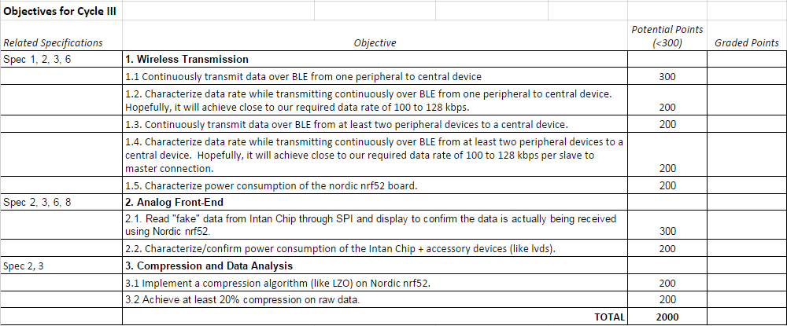
Cycle III Functional Specifications

Slide 6
1. Wireless Transmission
Continuously transmit data over BLE from one peripheral to central device
Characterize data rate while transmitting continuously from one peripheral to central
Continuously transmit data over BLE from multiple peripheral to central device
Characterize data rate while transmitting continuously from multiple peripherals to one central
Characterize power consumption of Nordic nRF52

Slide 7
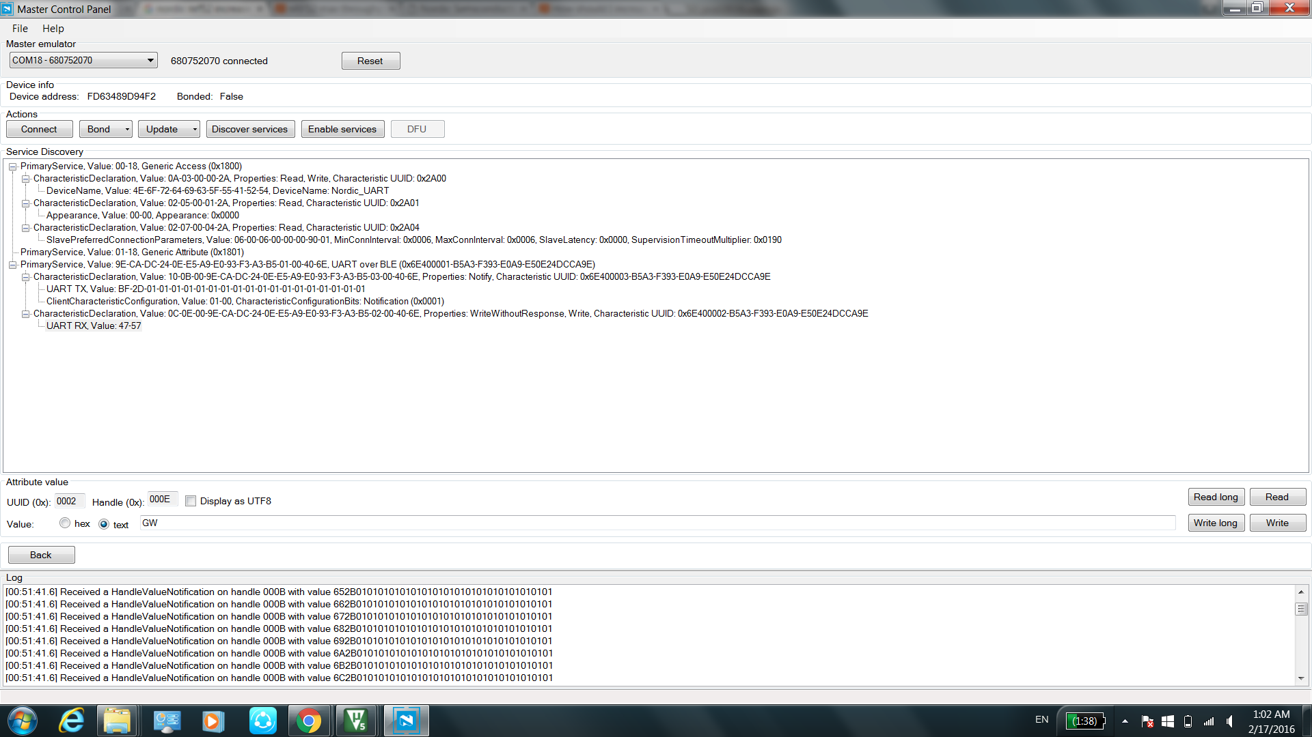
1.1 Continuous Transmission Over One Link

Slide 8
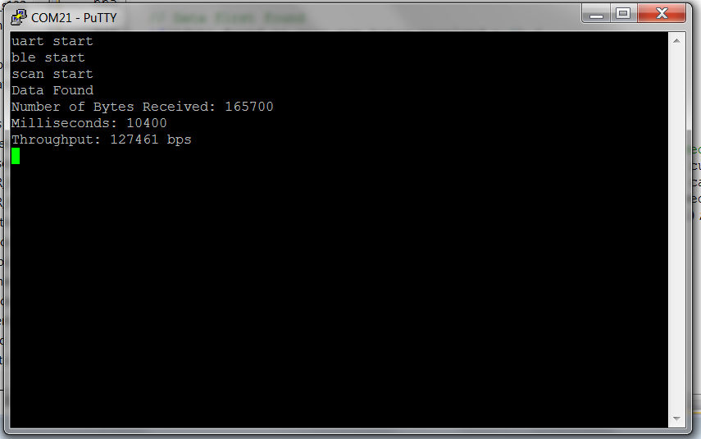
1.2 Characterize Throughput Over One Link

Slide 9
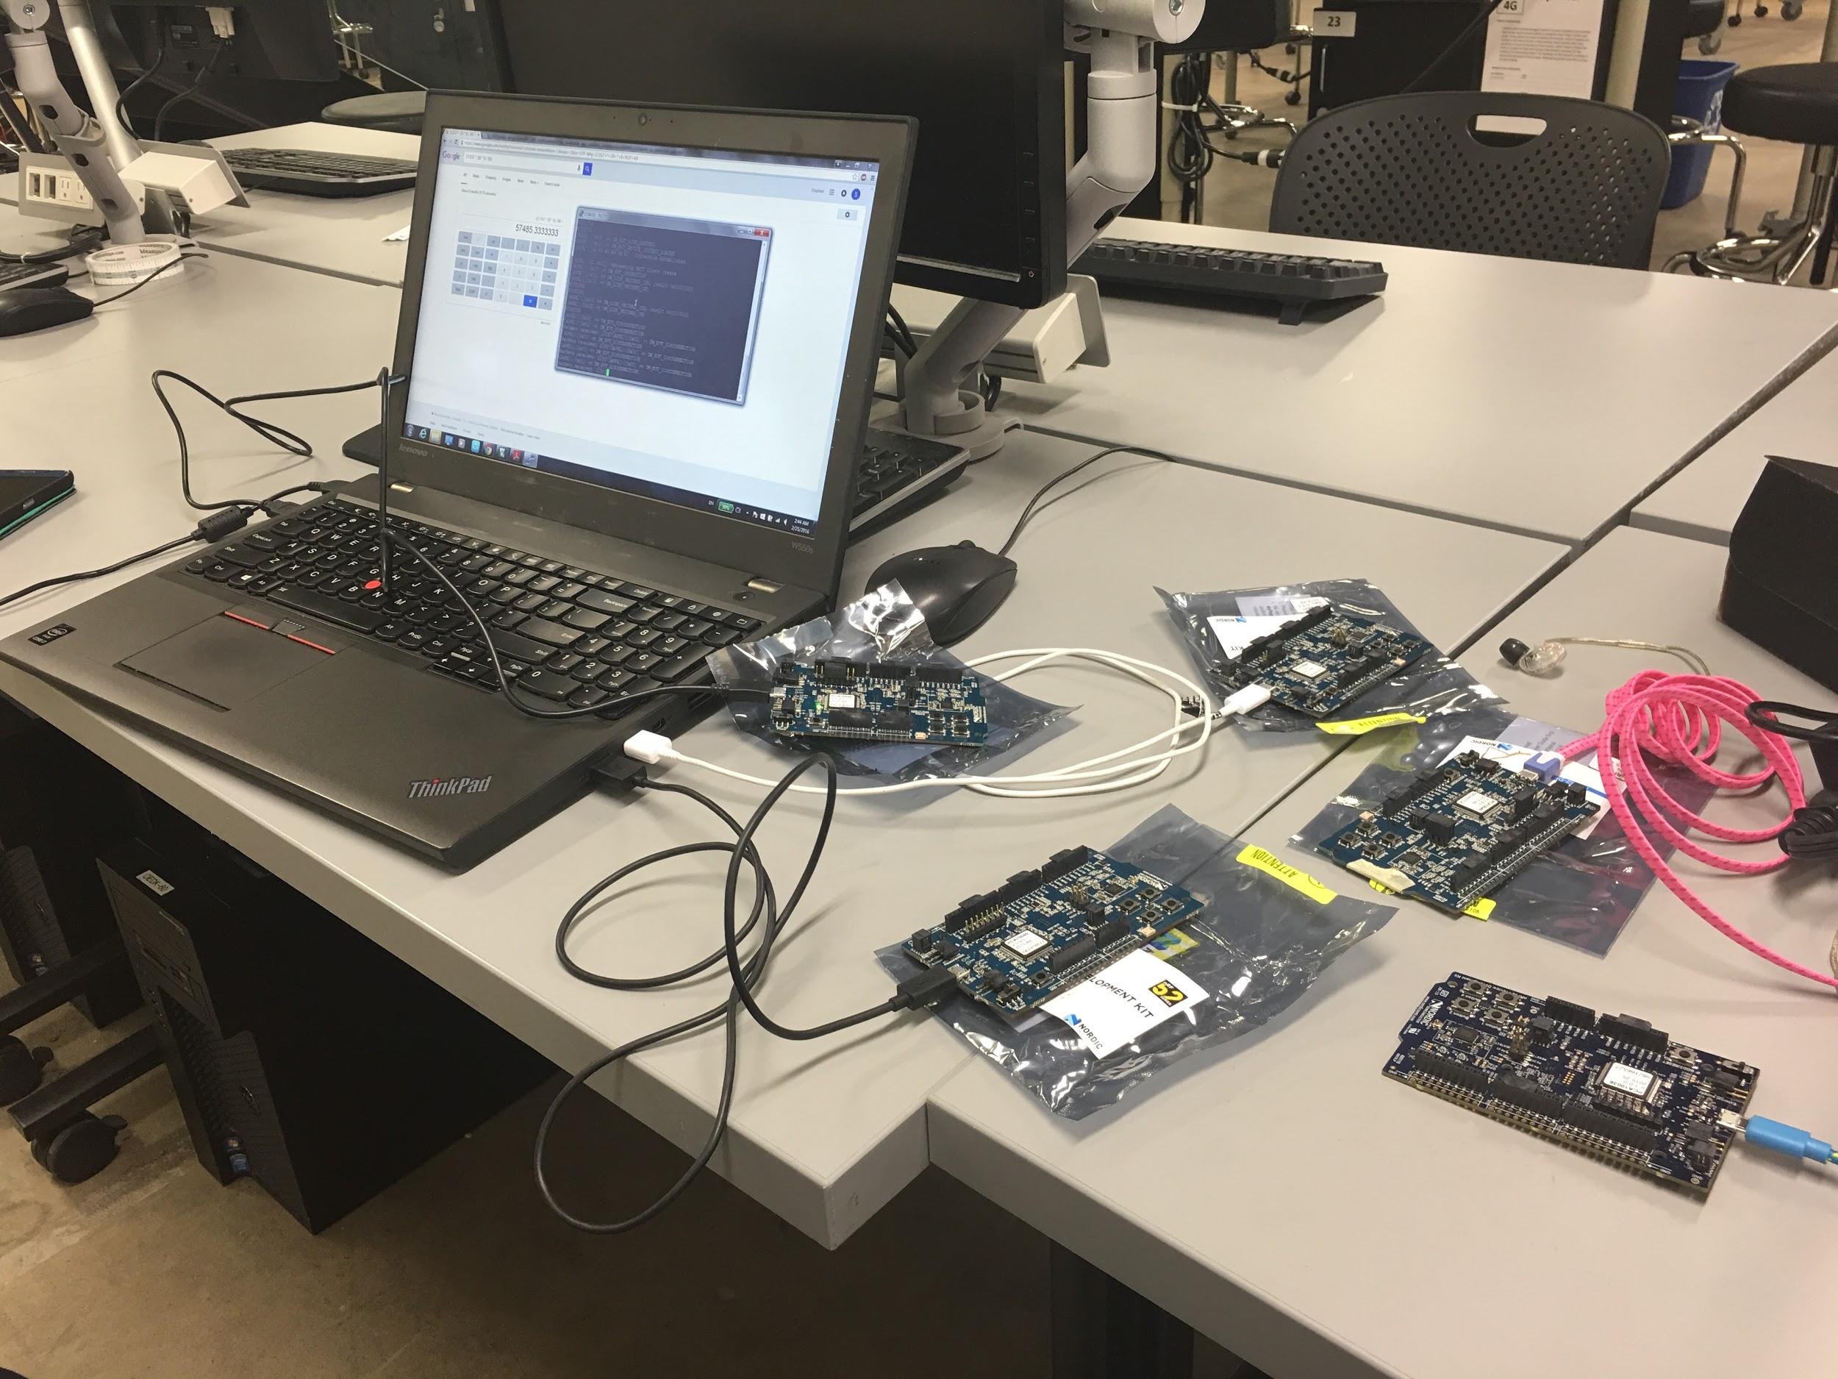
1.3 Continuous Transmission Over Multiple Links
4 Peripherals
1 Central

Slide 10
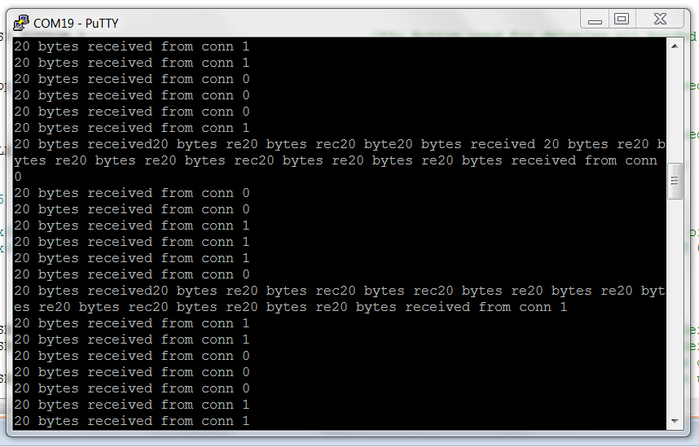
1.3 Continuous Transmission Over Multiple Links
2 peripherals transmitting to 1 central: conn0 , conn1

Slide 11
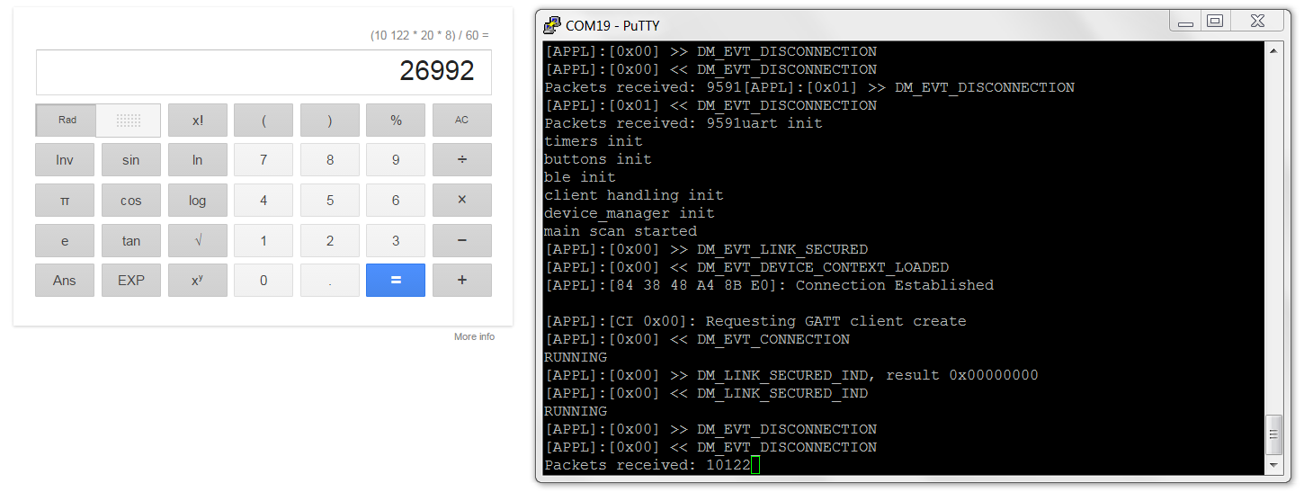
1.4 Characterize Throughput Over Multiple Links
1 peripheral transmitting to 1 central throughput test

Slide 12
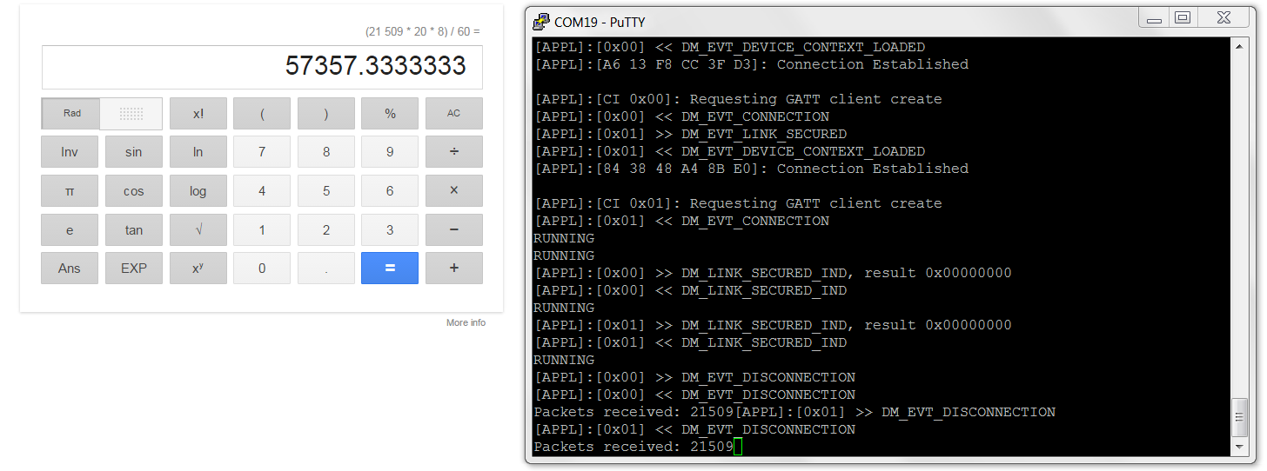
1.4 Characterize Throughput Over Multiple Links
2 peripherals transmitting to 1 central throughput test

Slide 13
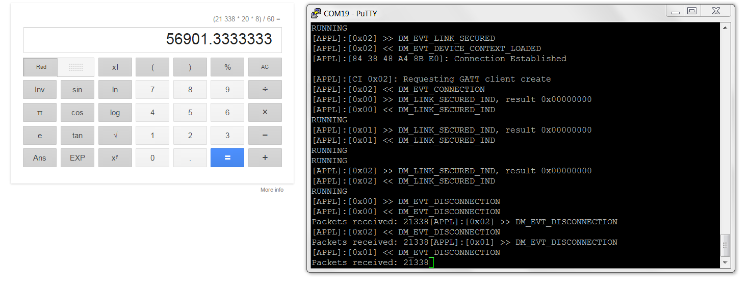
1.4 Characterize Throughput Over Multiple Links
3 peripherals transmitting to 1 central throughput test

Slide 14
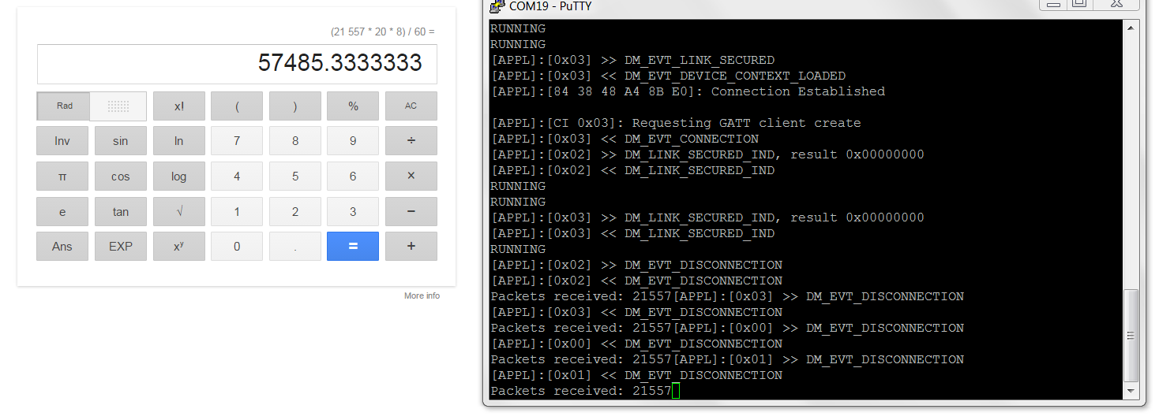
1.4 Characterize Throughput Over Multiple Links
4 peripherals transmitting to 1 central throughput test

Slide 15
1.5 Power Feasibility: BLE Transmission - NRF52
Spec Sheet Transmit at +0 dBm:
5.5 mA
Power Consumption with 3.3 V power supply: 3.3V * 5.5 mA = 18.15 mW
To run for 24 hours: 5.5 mA * 24 hours = 132 mAh
Production Board Testing at +0 dBm
Advertising: 0.9 mA
Advertising to TX switch and TX ramp up: 6.85 mA
Steady state 128kbps transmission: 6.0 mA
Average 6.1mA * 24 hours = 147 mAh

Slide 16
2. Analog Front-End
2.1. Read "fake" data from Intan Chip through SPI and display to confirm the data is actually being received using Nordic nrf52.
2.2. Characterize/confirm power consumption of the Intan Chip + accessory devices (i.e. LVDS).

Slide 17
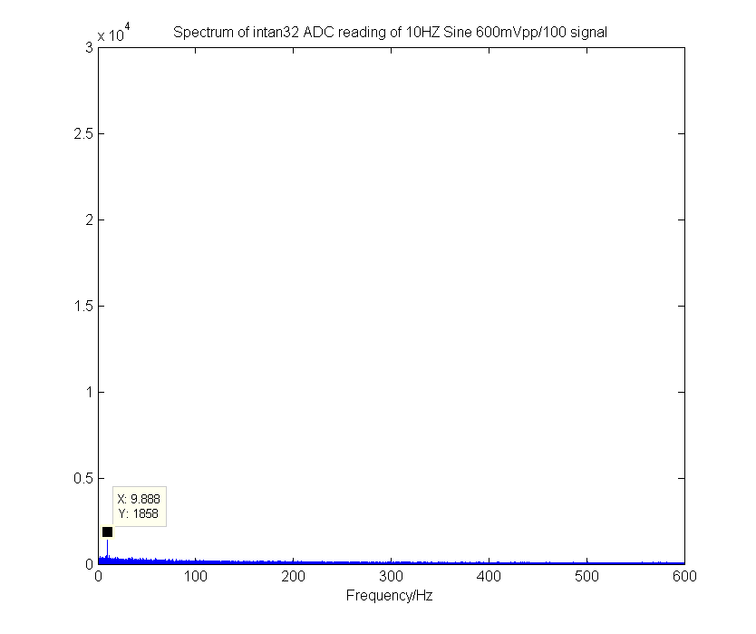
2.1 Data Conversion
Tested with 10Hz sine signal
Vpp = 600mVpp/100 = 6mVpp

Slide 18
2.2 Power Feasibility: AFE - Intan RHD2000 (Calculated)
Amplifier Current:
200 uA + 16 * 1* 7.6 uA/Khz/channel = 321.6 uA
ADC Current:
510 uA + 16 * 1 * 2.14 uA/kHz/channel = 544.24 uA
Supply Voltage and Auxiliary Inputs:
40 uA
Total Power Consumption with 3.3V Supply
(321.6 + 544.24 + 40) uA = 905.84 uA
3.3 * 905.84 uA = 2.99 mW
To run for 24 hours: 905.84 uA * 24 hours = 21.74 mAh

Slide 19
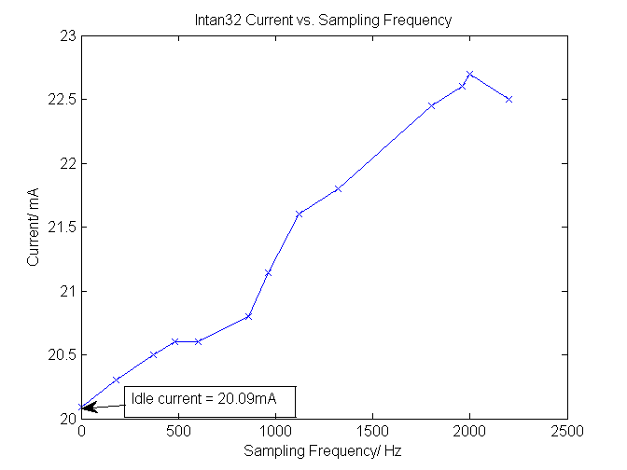
2.2 Power Feasibility: AFE - Intan RHD2000 (Observed)
Observed 21mA
Total Power Consumption with 3.3V Supply
To run for 24 hours: 21mAh * 24 hours = 504 mAh
However prototype is interfacing with an LVDS chip
25 mA max supply current draw
Accounts for the additional 20mA draw

Slide 20
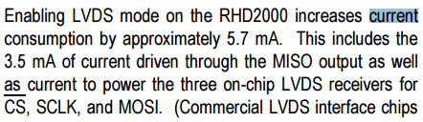
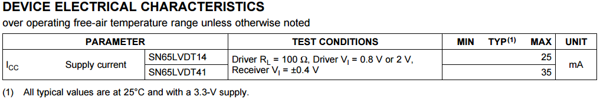
2.2 Power Characteristics of Intan and LVDS
21mA (total) - 1mA (ADC) - 5.7 mA (Intan LVDS mode) = 14.3mA (TI LVDS converter)
Intan
TI LVDS

Slide 21
Bonus: Total System Power Consumption
Total available power: 310 mAh @ 2.9V
Assuming 90% charge transfer efficiency: 279 mAh
Total Power Consumption 24 hours: 169 mAh @ 3.3V
149 mAh @ 2.9V
Intan RHD2132
22 mAh for 24 hours without LVDS
504 mAh for 24 hours with LVDS
Nordic NRF 52
147 mAh for 24 hours

Slide 22
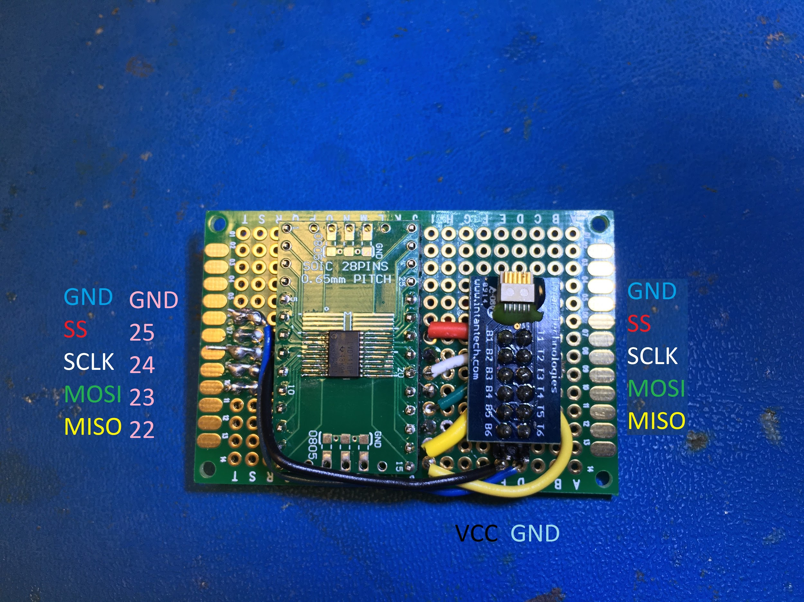
2.extra PERFBOARD
Minimize error
Eliminate long jumper

Slide 23
3. Compression and Data Analysis
3.1 Implement a compression algorithm (like LZO) on Nordic nrf52.
3.2 Achieve at least 20% compression on raw data.

Slide 24
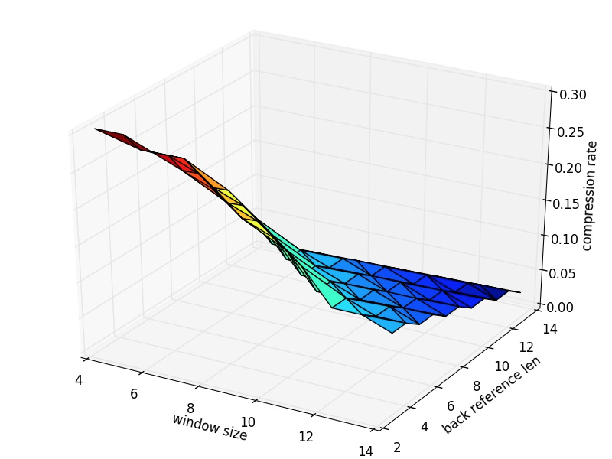
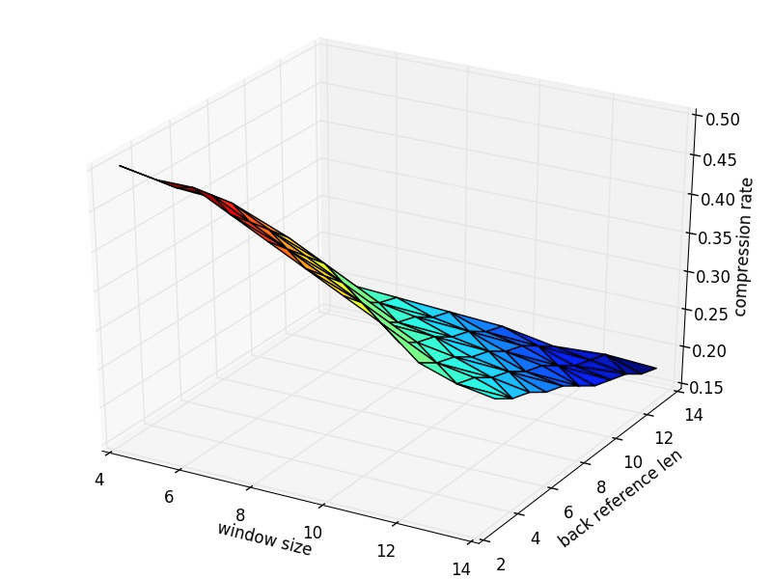
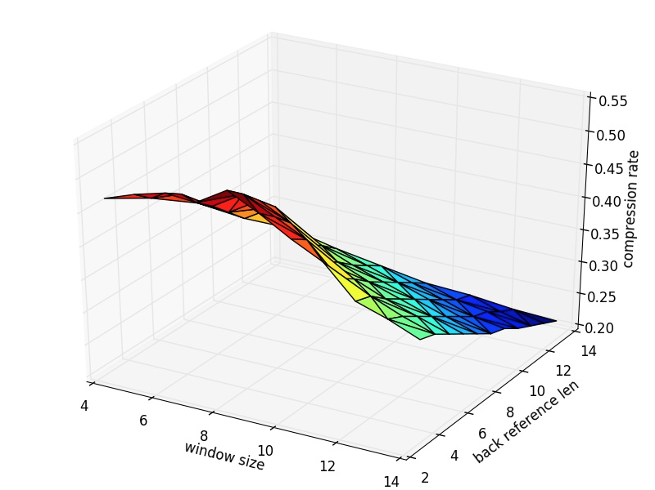
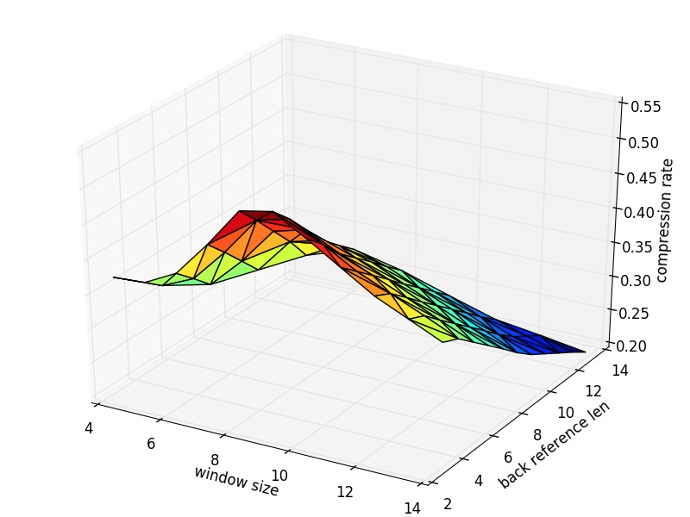
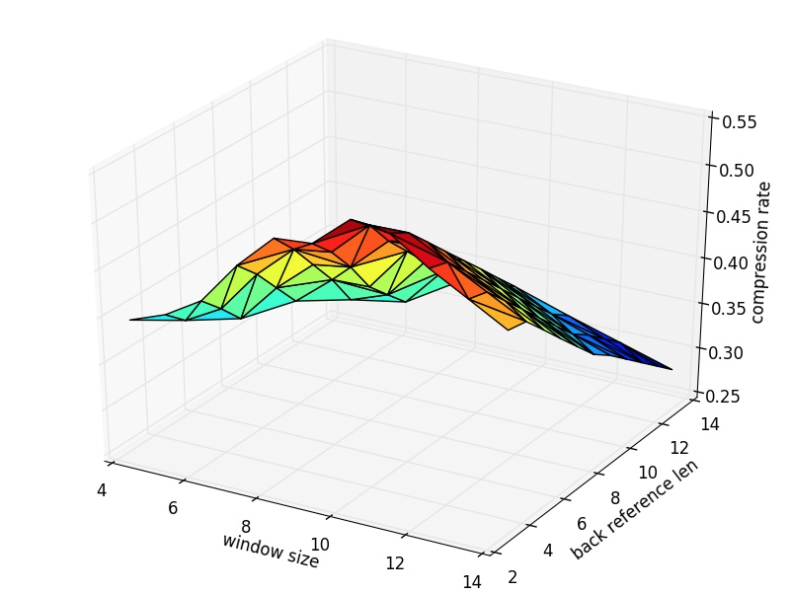
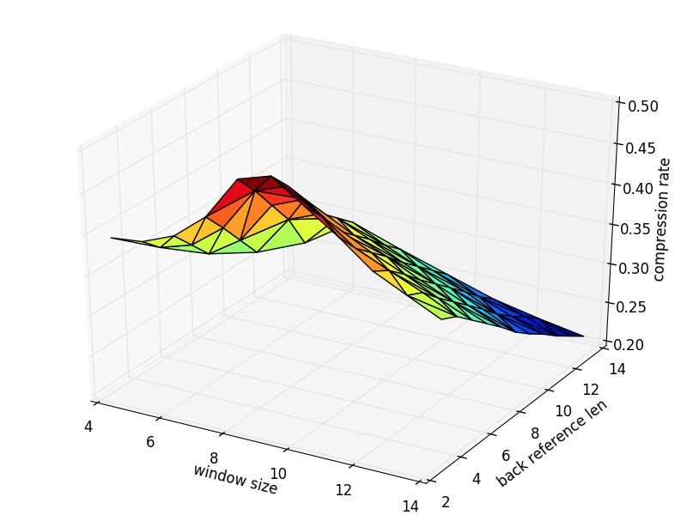

Slide 25
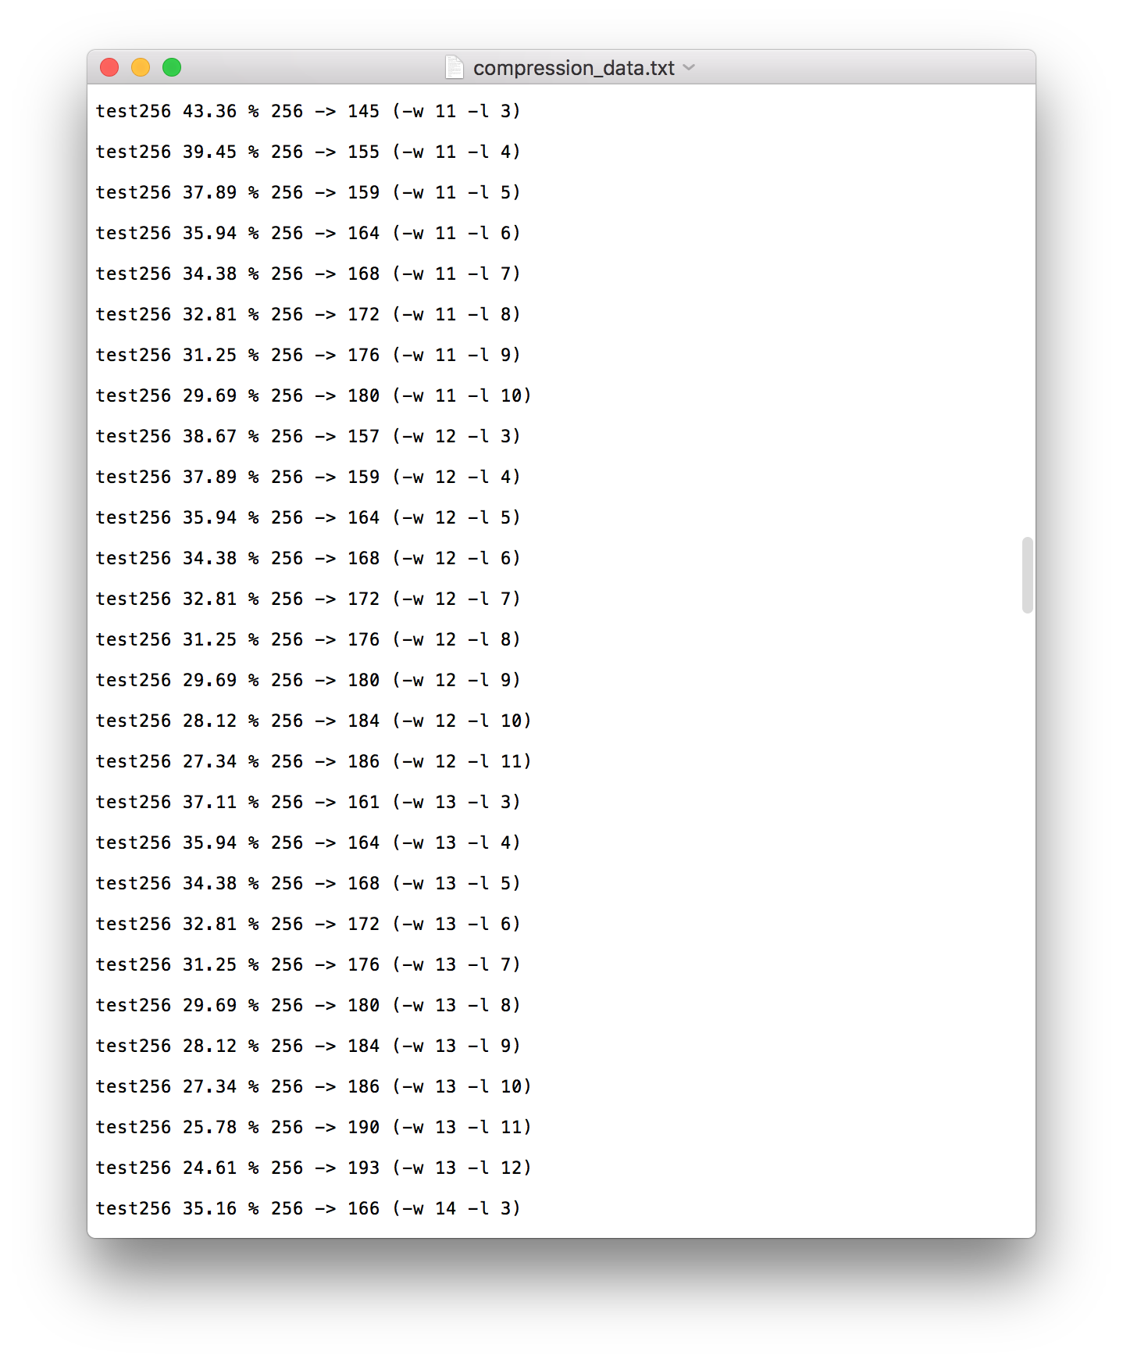
Heatshrink Compression Results on PC (H 8,4)
H(8,4) =
Windows size 2^8,
Reference 2^4 (length of pattern)
Dynamic window size and reference length changing is not practical on nRF52. Use static compression with fixed setup instead.

Slide 26
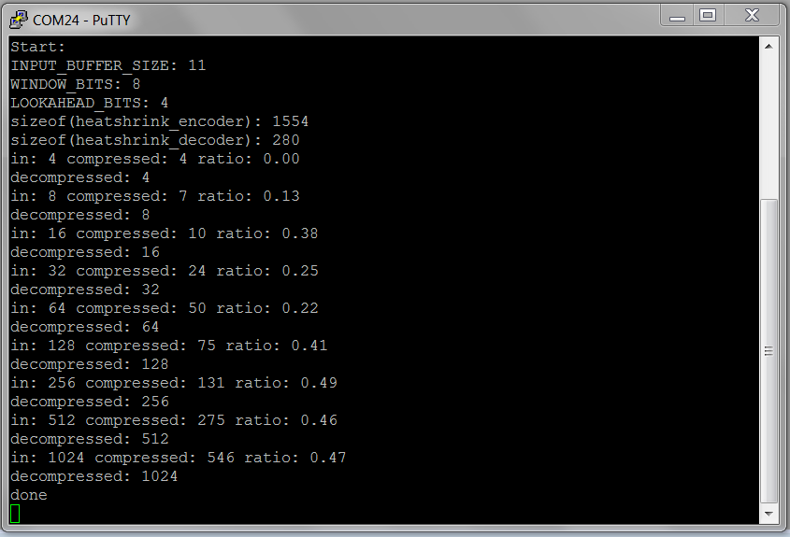
Heatshrink Compression Results on Nordic (H 8,4)

Slide 27
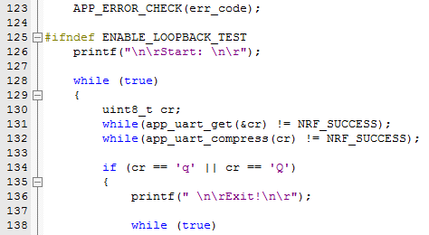
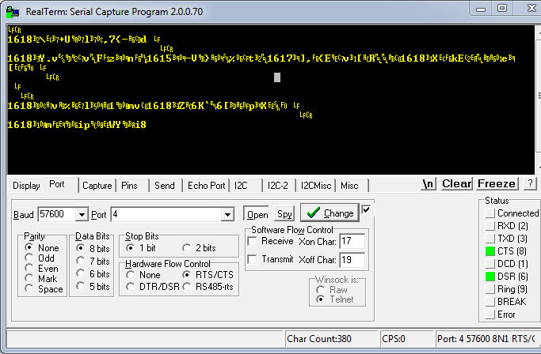
2048 Bytes, window size = 2^10, reference length = 3

Slide 28
Memory Allocation
0x 00
RAM = RW (Data differ from 0) + ZI (Zero Initialized)
Flash = Code + RO (Read Only) + RW
On nRF52-s132, RAM = 64kB, Flash = 512kB
Use Const type qualifier to store data in Flash.
Static will take up both RAM and Flash.
Use MicroLib for compilation to save 28kB.
….
0x4000
0x20008000
….
0x202C0000

Slide 29
“Sleep is a poor substitute for coffee.”
-- Abraham Lincoln

Slide 30


